Slide 1
Chapter Five
Demand
需求

Slide 2
Properties of Demand Functions
Comparative statics analysis （比较静态分析）of ordinary demand functions -- the study of how ordinary demands x₁*(p₁,p₂,y) and x₂*(p₁,p₂,y) change as prices p₁, p₂ and income y change.

Slide 3
Structure
Own-price changes
  Price offer curve （价格提供曲线）
  Ordinary demand curve
  Inverse demand curve （反需求函数）
Income changes
  Income offer curve （收入提供曲线）
  Engel curve （恩格尔曲线）
Cross-price effects

Slide 4
Own-Price Changes
How does x₁*(p₁,p₂,y) change as p₁ changes, holding p₂ and y constant?
Suppose only p₁ increases, from p₁’ to p₁’’ and then to p₁’’’.

Slide 5
Own-Price Changes
Fixed p₂ and y.
x₂
p₁x₁ + p₂x₂ = y
p₁ = p₁’
x₁

Slide 6
Own-Price Changes
Fixed p₂ and y.
x₂
p₁x₁ + p₂x₂ = y
p₁ = p₁’
p₁= p₁’’
x₁

Slide 7
Own-Price Changes
Fixed p₂ and y.
x₂
p₁x₁ + p₂x₂ = y
p₁ = p₁’
p₁=
p₁’’’
p₁= p₁’’
x₁

Slide 8
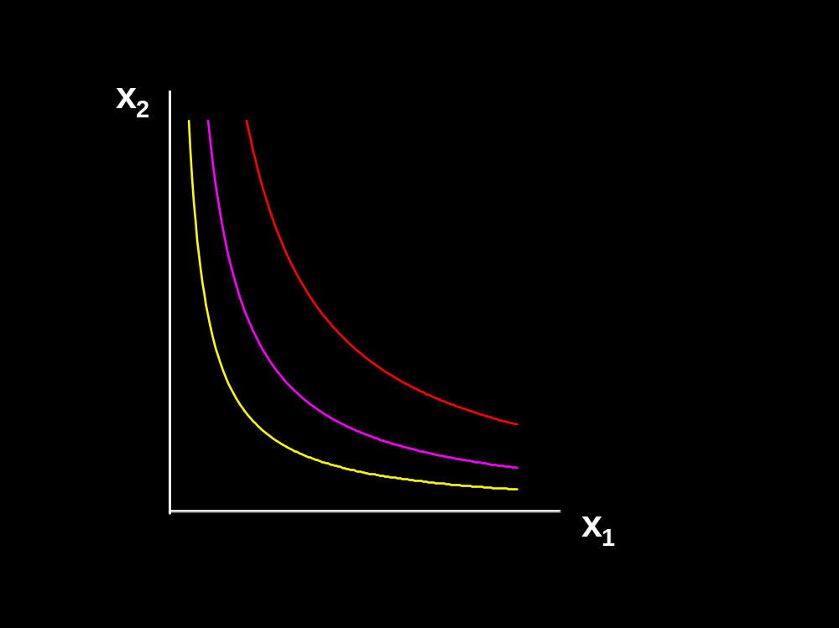
Own-Price Changes
Fixed p₂ and y.
p₁ = p₁’
x₁*(p₁’)

Slide 9
p₁
Own-Price Changes
Fixed p₂ and y.
p₁ = p₁’
p₁’
x₁*(p₁’)
x₁*
x₁*(p₁’)

Slide 10
p₁
Own-Price Changes
Fixed p₂ and y.
p₁ = p₁’’
p₁’
x₁*(p₁’)
x₁*
x₁*(p₁’)
x₁*(p₁’’)

Slide 11
p₁
Own-Price Changes
Fixed p₂ and y.
p₁’’
p₁’
x₁*(p₁’)
x₁*
x₁*(p₁’’)
x₁*(p₁’)
x₁*(p₁’’)

Slide 12
p₁
Own-Price Changes
Fixed p₂ and y.
p₁ = p₁’’’
p₁’’
p₁’
x₁*(p₁’)
x₁*
x₁*(p₁’’)
x₁*(p₁’’’)
x₁*(p₁’)
x₁*(p₁’’)

Slide 13
p₁
Own-Price Changes
Ordinary
demand curve
for commodity 1
Fixed p₂ and y.
p₁’’’
p₁’’
p₁’
x₁*(p₁’’’)
x₁*(p₁’)
x₁*
x₁*(p₁’’)
x₁*(p₁’’’)
x₁*(p₁’)
x₁*(p₁’’)

Slide 14
p₁
Own-Price Changes
Ordinary
demand curve
for commodity 1
Fixed p₂ and y.
p₁’’’
p₁’’
p₁ price
offer
curve
p₁’
x₁*(p₁’’’)
x₁*(p₁’)
x₁*
x₁*(p₁’’)
x₁*(p₁’’’)
x₁*(p₁’)
x₁*(p₁’’)

Slide 15
Own-Price Changes
The curve containing all the utility-maximizing bundles traced out as p₁ changes, with p₂ and y constant, is the p₁- price offer curve.
The plot of the x₁-coordinate of the p₁- price offer curve against p₁ is the ordinary demand curve for commodity 1.

Slide 16
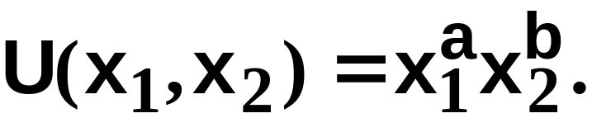
Own-Price Changes
What does a p₁ price-offer curve look like for Cobb-Douglas preferences?
Take
Then the ordinary demand functions for commodities 1 and 2 are

Slide 17
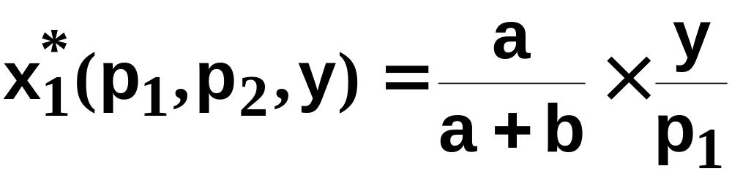
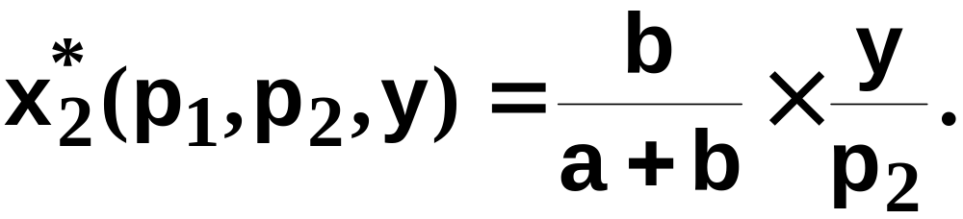
Own-Price Changes
and
Notice that x₂* does not vary with p₁ so the
p₁ price offer curve is flat.

Slide 18
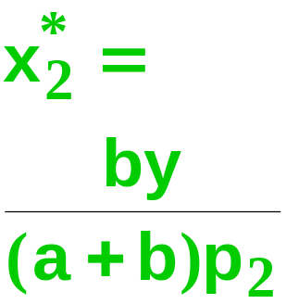
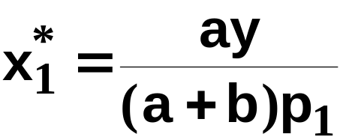
Own-Price Changes
Fixed p₂ and y.
x₁*(p₁’’’)
x₁*(p₁’)
x₁*(p₁’’)

Slide 19
p₁
Own-Price Changes
Ordinary
demand curve
for commodity 1
is
Fixed p₂ and y.
x₁*
x₁*(p₁’’’)
x₁*(p₁’)
x₁*(p₁’’)

Slide 20

Own-Price Changes
What does a p₁ price-offer curve look like for a perfect-complements utility function?
Then the ordinary demand functions
for commodities 1 and 2 are

Slide 21
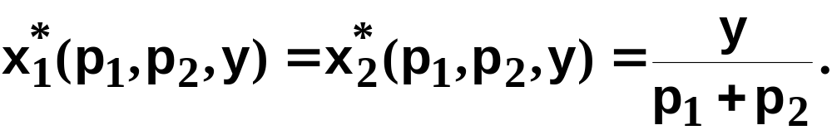
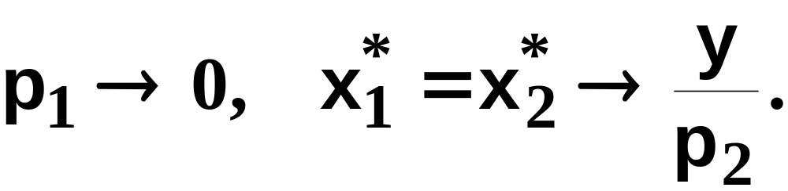
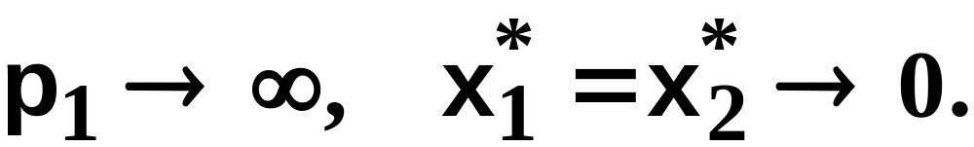
Own-Price Changes
With p₂ and y fixed, higher p₁ causes
smaller x₁* and x₂*.
As
As

Slide 22
Own-Price Changes
Fixed p₂ and y.
x₂
x₁

Slide 23
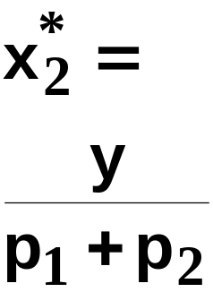
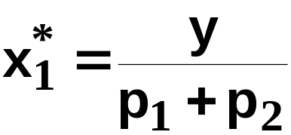

p₁
Own-Price Changes
Fixed p₂ and y.
x₂
p₁ = p₁’
y/p₂
p₁’
’
x₁*
’
x₁
’

Slide 24
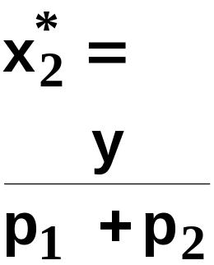
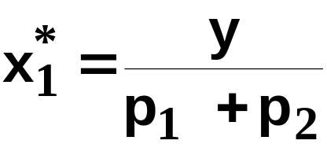
p₁
Own-Price Changes
Fixed p₂ and y.
x₂
p₁ = p₁’’
y/p₂
p₁’’
p₁’
x₁*
’’
’’
x₁
’’

Slide 25
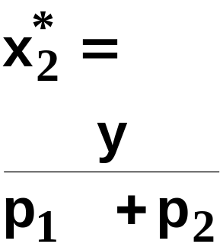


p₁
Own-Price Changes
Fixed p₂ and y.
p₁’’’
x₂
p₁ = p₁’’’
y/p₂
p₁’’
p₁’
x₁*
’’’
’’’
x₁
’’’

Slide 26
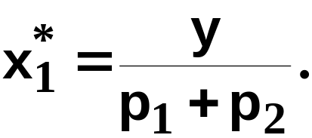

p₁
Own-Price Changes
Ordinary
demand curve
for commodity 1
is
Fixed p₂ and y.
p₁’’’
x₂
y/p₂
p₁’’
p₁’
x₁*
x₁

Slide 27

Own-Price Changes
What does a p₁ price-offer curve look like for a perfect-substitutes utility function?
Then the ordinary demand functions
for commodities 1 and 2 are

Slide 28
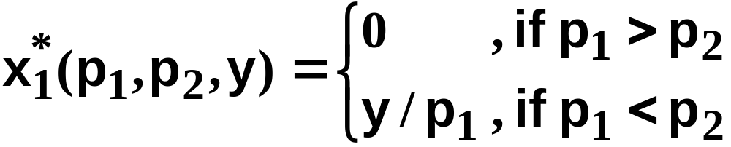
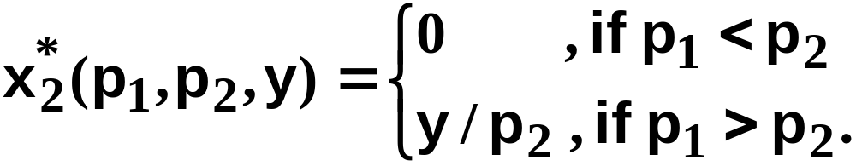
Own-Price Changes
and

Slide 29
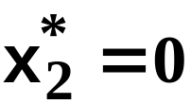
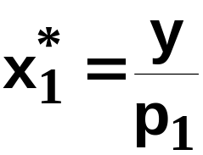
Own-Price Changes
Fixed p₂ and y.
Fixed p₂ and y.
x₂
p₁ = p₁’ < p₂
x₁
’

Slide 30
p₁
Own-Price Changes
Fixed p₂ and y.
Fixed p₂ and y.
x₂
p₁ = p₁’ < p₂
p₁’
x₁*
’
x₁
’

Slide 31
p₁
Own-Price Changes
Fixed p₂ and y.
Fixed p₂ and y.
x₂
p₁ = p₁’’ = p₂
p₁’
x₁*
x₁

Slide 32
p₁
Own-Price Changes
Fixed p₂ and y.
Fixed p₂ and y.
x₂
p₁ = p₁’’ = p₂
p₁’
x₁*
x₁

Slide 33
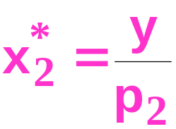


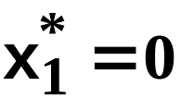
p₁
Own-Price Changes
Fixed p₂ and y.
Fixed p₂ and y.
x₂
p₁ = p₁’’ = p₂
p₁’
x₁*
x₁
’’

Slide 34
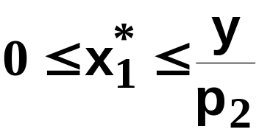
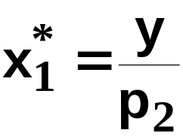
p₁
Own-Price Changes
Fixed p₂ and y.
Fixed p₂ and y.
x₂
p₁ = p₁’’ = p₂
p₂ = p₁’’
p₁’
x₁*
x₁

Slide 35

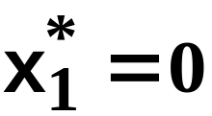
p₁
Own-Price Changes
Fixed p₂ and y.
Fixed p₂ and y.
p₁’’’
x₂
p₁ = p₁”’ > p₂
p₂ = p₁’’
p₁’
x₁*
x₁

Slide 36


p₁
Own-Price Changes
Ordinary
demand curve
for commodity 1
Fixed p₂ and y.
Fixed p₂ and y.
p₁’’’
x₂
p₂ = p₁’’
p₁ price
offer
curve
p₁’
x₁*
x₁

Slide 37
Own-Price Changes
Usually we ask “Given the price for commodity 1 what is the quantity demanded of commodity 1?”
But we could also ask the inverse question “At what price for commodity 1 would a given quantity of commodity 1 be demanded?”

Slide 38
Own-Price Changes
p₁
Given p₁’, what quantity is
demanded of commodity 1?
p₁’
x₁*

Slide 39
Own-Price Changes
p₁
Given p₁’, what quantity is
demanded of commodity 1?
Answer: x₁’ units.
p₁’
x₁’
x₁*

Slide 40
Own-Price Changes
p₁
Given p₁’, what quantity is
demanded of commodity 1?
Answer: x₁’ units.
The inverse question is:
Given x₁’ units are
demanded, what is the
price of
commodity 1?
x₁’
x₁*

Slide 41
Own-Price Changes
p₁
Given p₁’, what quantity is
demanded of commodity 1?
Answer: x₁’ units.
The inverse question is:
Given x₁’ units are
demanded, what is the
price of
commodity 1?
Answer: p₁’
p₁’
x₁’
x₁*

Slide 42
Own-Price Changes
Taking quantity demanded as given and then asking what must be price describes the inverse demand function of a commodity.

Slide 43
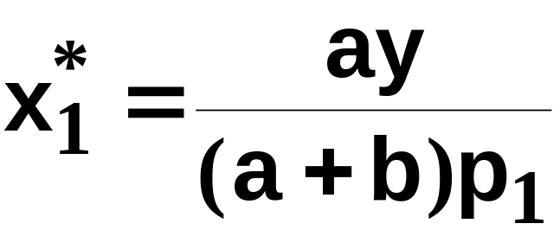
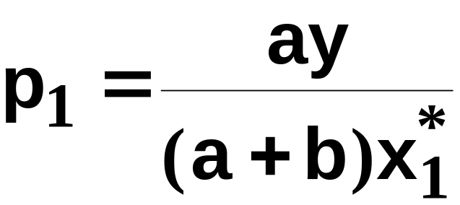
Own-Price Changes
A Cobb-Douglas example:
is the ordinary demand function and
is the inverse demand function.

Slide 44
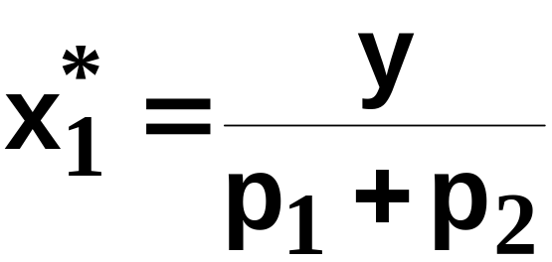
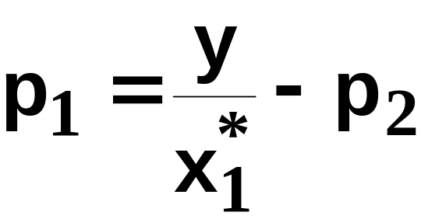
Own-Price Changes
A perfect-complements example:
is the ordinary demand function and
is the inverse demand function.

Slide 45
Income Changes
How does the value of x₁*(p₁,p₂,y) change as y changes, holding both p₁ and p₂ constant?

Slide 46
Income Changes
Fixed p₁ and p₂.
y’ < y’’ < y’’’

Slide 47
Income Changes
Fixed p₁ and p₂.
y’ < y’’ < y’’’

Slide 48
Income Changes
Fixed p₁ and p₂.
y’ < y’’ < y’’’
x₂’’’
x₂’’
x₂’
x₁’
x₁’’’
x₁’’

Slide 49
Income Changes
Fixed p₁ and p₂.
y’ < y’’ < y’’’
Income
offer curve
x₂’’’
x₂’’
x₂’
x₁’
x₁’’’
x₁’’

Slide 50
Income Changes
A plot of quantity demanded against income is called an Engel curve.

Slide 51
Income Changes
Fixed p₁ and p₂.
y’ < y’’ < y’’’
Income
offer curve
x₂’’’
x₂’’
x₂’
x₁’
x₁’’’
x₁’’

Slide 52
Income Changes
Fixed p₁ and p₂.
y’ < y’’ < y’’’
Income
offer curve
y
x₂’’’
y’’’
x₂’’
Engel
curve;
good 1
y’’
x₂’
y’
x₁’
x₁’’’
x₁’
x₁’’’
x₁*
x₁’’
x₁’’

Slide 53
Income Changes
y
Engel
curve;
good 2
Fixed p₁ and p₂.
y’’’
y’’
y’ < y’’ < y’’’
y’
Income
offer curve
x₂’
x₂’’’
x₂*
x₂’’
x₂’’’
x₂’’
x₂’
x₁’
x₁’’’
x₁’’

Slide 54
Income Changes
y
Engel
curve;
good 2
Fixed p₁ and p₂.
y’’’
y’’
y’ < y’’ < y’’’
y’
Income
offer curve
y
x₂’
x₂’’’
x₂*
x₂’’
x₂’’’
y’’’
x₂’’
Engel
curve;
good 1
y’’
x₂’
y’
x₁’
x₁’’’
x₁’
x₁’’’
x₁*
x₁’’
x₁’’

Slide 55
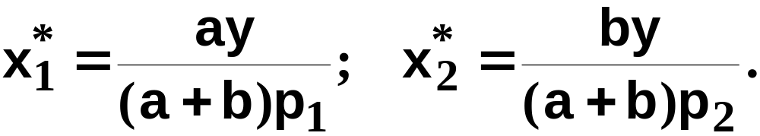
Income Changes and Cobb-Douglas Preferences
An example of computing the equations of Engel curves; the Cobb-Douglas case.
The ordinary demand equations are

Slide 56
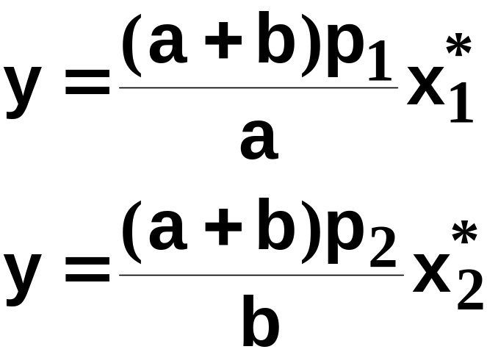
Income Changes and Cobb-Douglas Preferences
Rearranged to isolate y, these are:
Engel curve for good 1
Engel curve for good 2

Slide 57
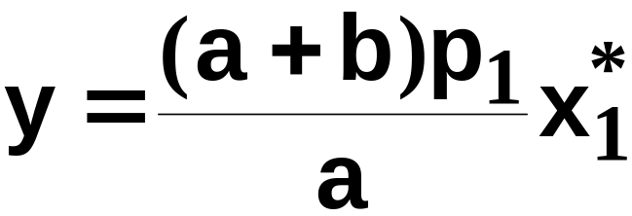
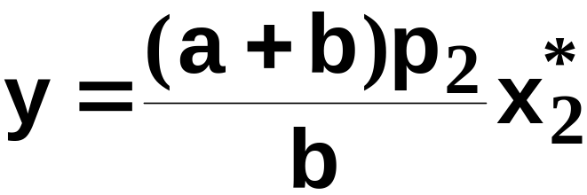
Income Changes and Cobb-Douglas Preferences
y
Engel curve
for good 1
x₁*
y
Engel curve
for good 2
x₂*

Slide 58
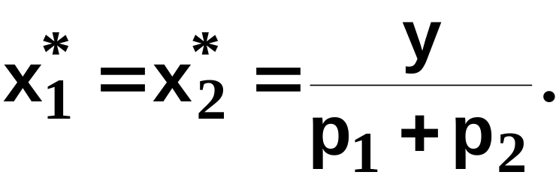
Income Changes and Perfectly-Complementary Preferences
Another example of computing the equations of Engel curves; the perfectly-complementary case.
The ordinary demand equations are

Slide 59
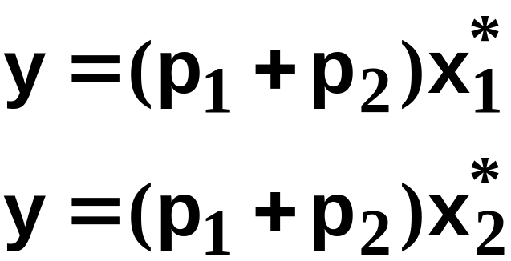
Income Changes and Perfectly-Complementary Preferences
Rearranged to isolate y, these are:
Engel curve for good 1
Engel curve for good 2

Slide 60
Income Changes
Fixed p₁ and p₂.
x₂
x₁

Slide 61
Income Changes
Fixed p₁ and p₂.
x₂
y’ < y’’ < y’’’
x₁

Slide 62
Income Changes
Fixed p₁ and p₂.
x₂
y’ < y’’ < y’’’
x₁

Slide 63
Income Changes
Fixed p₁ and p₂.
x₂
y’ < y’’ < y’’’
x₂’’’
x₂’’
x₂’
x₁’
x₁’’’
x₁
x₁’’

Slide 64
Income Changes
Fixed p₁ and p₂.
x₂
y’ < y’’ < y’’’
y
x₂’’’
y’’’
x₂’’
Engel
curve;
good 1
y’’
x₂’
y’
x₁’
x₁’’’
x₁’
x₁’’’
x₁*
x₁
x₁’’
x₁’’

Slide 65
Income Changes
y
Engel
curve;
good 2
Fixed p₁ and p₂.
y’’’
x₂
y’’
y’ < y’’ < y’’’
y’
x₂’
x₂’’’
x₂*
x₂’’
x₂’’’
x₂’’
x₂’
x₁’
x₁’’’
x₁
x₁’’

Slide 66
Income Changes
y
Engel
curve;
good 2
Fixed p₁ and p₂.
y’’’
x₂
y’’
y’ < y’’ < y’’’
y’
y
x₂’
x₂’’’
x₂*
x₂’’
x₂’’’
y’’’
x₂’’
Engel
curve;
good 1
y’’
x₂’
y’
x₁’
x₁’’’
x₁’
x₁’’’
x₁*
x₁
x₁’’
x₁’’

Slide 67
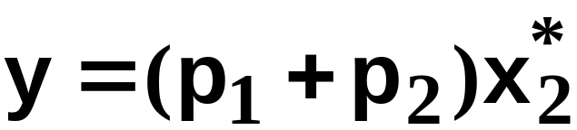
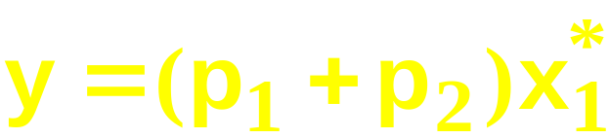
Income Changes
y
Engel
curve;
good 2
Fixed p₁ and p₂.
y’’’
y’’
y’
y
x₂’
x₂’’’
x₂*
x₂’’
y’’’
Engel
curve;
good 1
y’’
y’
x₁’
x₁’’’
x₁*
x₁’’

Slide 68
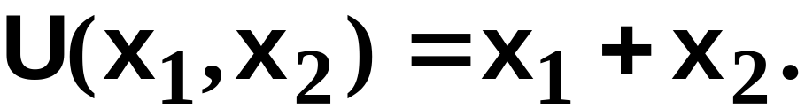
Income Changes and Perfectly-Substitutable Preferences
Another example of computing the equations of Engel curves; the perfectly-substitution case.
The ordinary demand equations are

Slide 69

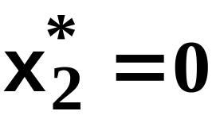
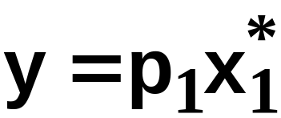
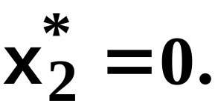
Income Changes and Perfectly-Substitutable Preferences
Suppose p₁ < p₂. Then
and
and

Slide 70
Income Changes and Perfectly-Substitutable Preferences
y
y
x₁*
0
x₂*
Engel curve
for good 1
Engel curve
for good 2

Slide 71
Income Changes
In every example so far the Engel curves have all been straight lines?
Q: Is this true in general?
A: No. Engel curves are straight lines if the consumer’s preferences are homothetic.

Slide 72
Homotheticity （位似偏好）
A consumer’s preferences are homothetic if and only if
for every k > 0.
That is, the consumer’s MRS is the same anywhere on a straight line drawn from the origin.
⇔
(x₁,x₂) ≿ (y₁,y₂) (kx₁,kx₂) ≿ (ky₁,ky₂)

Slide 73
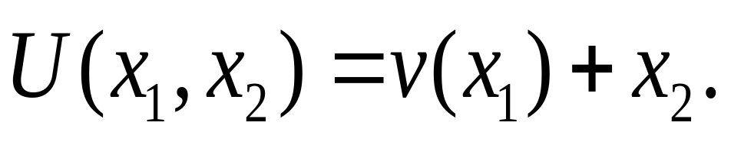
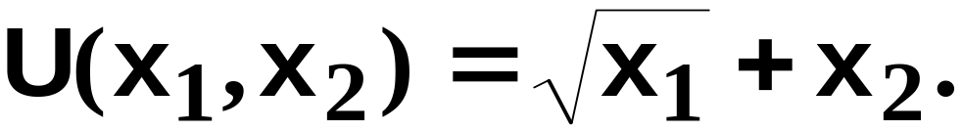
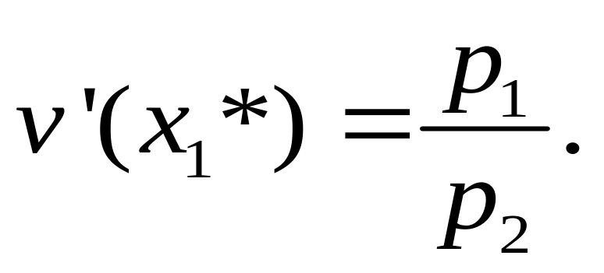
Income Effects -- A Nonhomothetic Example
Quasilinear preferences are not homothetic.
For example,
Optimal interior consumption:

Slide 74

Quasi-linear Indifference Curves
x₂
Each curve is a vertically shifted copy of the others.
Each curve intersects
both axes.
x₁

Slide 75

Income Changes; Quasilinear Utility
x₂
x₁
~
x₁

Slide 76
Income Changes; Quasilinear Utility
x₂
y
Engel
curve
for
good 1
~
x₁*
x₁
x₁
~
x₁

Slide 77
Income Changes; Quasilinear Utility
y
Engel
curve
for
good 2
x₂
x₂*
x₁
~
x₁

Slide 78
Income Changes; Quasilinear Utility
y
Engel
curve
for
good 2
x₂
x₂*
y
Engel
curve
for
good 1
~
x₁*
x₁
x₁
~
x₁

Slide 79
Income Effects
A good for which quantity demanded rises with income is called normal （正常品）.
Therefore a normal good’s Engel curve is positively sloped.

Slide 80
Income Effects
A good for which quantity demanded falls as income increases is called income inferior （劣质品）.
Therefore an income inferior good’s Engel curve is negatively sloped.

Slide 81
Income Changes; Goods
1 & 2 Normal
y
Engel
curve;
good 2
y’’’
y’’
y’
Income
offer curve
y
x₂’
x₂’’’
x₂*
x₂’’
x₂’’’
y’’’
x₂’’
Engel
curve;
good 1
y’’
x₂’
y’
x₁’
x₁’’’
x₁’
x₁’’’
x₁*
x₁’’
x₁’’

Slide 82
Income Changes; Good 2 Is Normal, Good 1 Becomes Income Inferior
x₂
Income
offer curve
x₁

Slide 83
Income Changes; Good 2 Is Normal, Good 1 Becomes Income Inferior
x₂
y
Engel curve
for good 1
x₁
x₁*

Slide 84
Income Changes; Good 2 Is Normal, Good 1 Becomes Income Inferior
y
x₂
Engel curve
for good 2
x₂*
y
Engel curve
for good 1
x₁
x₁*

Slide 85
Ordinary Goods （一般商品）
A good is called ordinary if the quantity demanded of it always increases as its own price decreases.

Slide 86
Ordinary Goods
Fixed p₂ and y.
x₂
p₁ price
offer
curve
x₁

Slide 87
Ordinary Goods
Fixed p₂ and y.
Downward-sloping
demand curve
x₂
p₁
p₁ price
offer
curve
⇔
Good 1 is
ordinary
x₁*
x₁

Slide 88
Giffen Goods （吉芬商品）
If, for some values of its own price, the quantity demanded of a good rises as its own-price increases then the good is called Giffen.

Slide 89
Ordinary Goods
Fixed p₂ and y.
x₂
p₁ price offer
curve
x₁

Slide 90
Ordinary Goods
Fixed p₂ and y.
Demand curve has
a positively
sloped part
x₂
p₁
p₁ price offer
curve
⇔
Good 1 is
Giffen
x₁*
x₁

Slide 91
Cross-Price Effects
If an increase in p₂
  increases demand for commodity 1 then commodity 1 is a gross substitute for commodity 2.
  reduces demand for commodity 1 then commodity 1 is a gross complement for commodity 2.

Slide 92

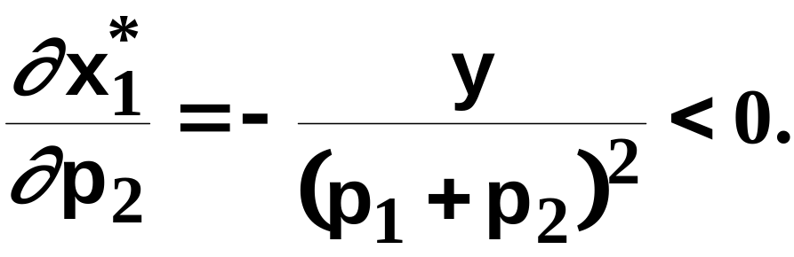
Cross-Price Effects
A perfect-complements example:
so
Therefore commodity 2 is a gross
complement for commodity 1.

Slide 93
Cross-Price Effects
p₁
Increase the price of
good 2 from p₂’ to p₂’’
and
p₁’’’
p₁’’
p₁’
x₁*
’

Slide 94
Cross-Price Effects
p₁
Increase the price of
good 2 from p₂’ to p₂’’
and the demand curve
for good 1 shifts inwards
-- good 2 is a
complement for good 1.
p₁’’’
p₁’’
p₁’
x₁*
’’

Slide 95
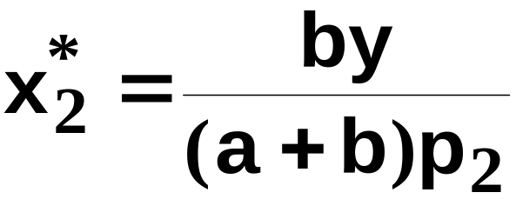
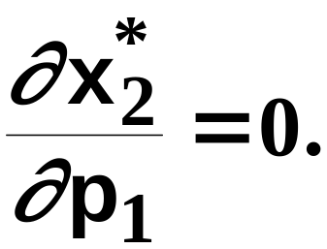
Cross-Price Effects
A Cobb- Douglas example:
so
Therefore commodity 1 is neither a gross
complement nor a gross substitute for
commodity 2.

